Slide 1
The Good Life Therapy Centre
Addiction & Self-Absorption
Sue Diamond Potts, M.A.
Founder/Director The Good Life Therapy Centre
Certified Developmental Couples Therapist
www.goodlifetherapy.ca

Slide 2
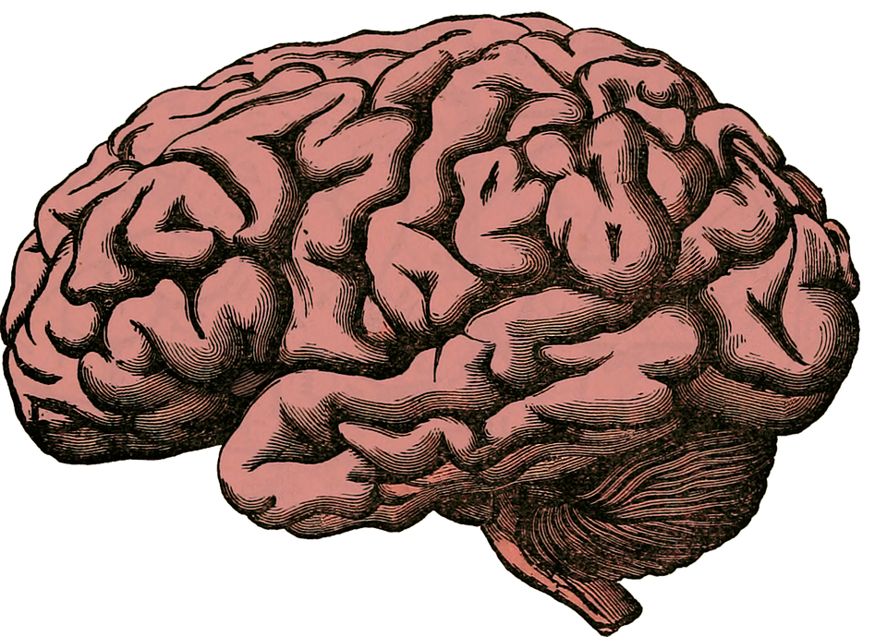
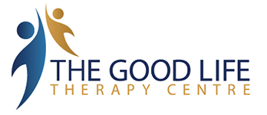
Addiction is:
1. A primary illness - a brain disease
2. A symptom of post traumatic stress/developmental trauma disorder
3. A systems disorder that is symbiotic in nature

Slide 3
There is a growing body of evidence of the structural vulnerability of brains to the effects of addictive substances.
Several factors contribute to this vulnerability:
Genetic
Early developmental influences & environmental factors
Effects of stressful life events across the life cycle
Mental disorders, especially depression & anxiety (Walker, 2008)

Slide 4
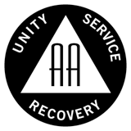
AA & Brain Science
In A.A. it is stressed that people drink essentially “for the effect it produces”.
What they didn’t know in 1939 is this: that alcohol and other drugs produce their effects by changing the neurochemistry in the predisposed brain; that this abnormal reaction make addicts feel ‘normal; and that their brains began to ‘adapt’ neurologically in a way that reinforces the dependency

Slide 5
The Brain Disease
The hold that addiction has on our minds lies in what has been called our reptile brain. It results from cellular changes in midbrain nuclei like the nucleus accumbens and the superior tegmentum.
(Vaillant, 2012)

Slide 6
The Brain Disease
Every disease has a disruption of normal cell activity as it’s basic cause.
In addiction it takes place in the neurons and is called neurotransmitter dysregulation.
(Erickson, 2007)

Slide 7
The Brain Disease
Dependency is a neuro-chemical imbalance that involves the site known as the mesolimbic dopamine system or what we more commonly know as “the pleasure pathway” or “reward” system
(Erickson, 2007)

Slide 8
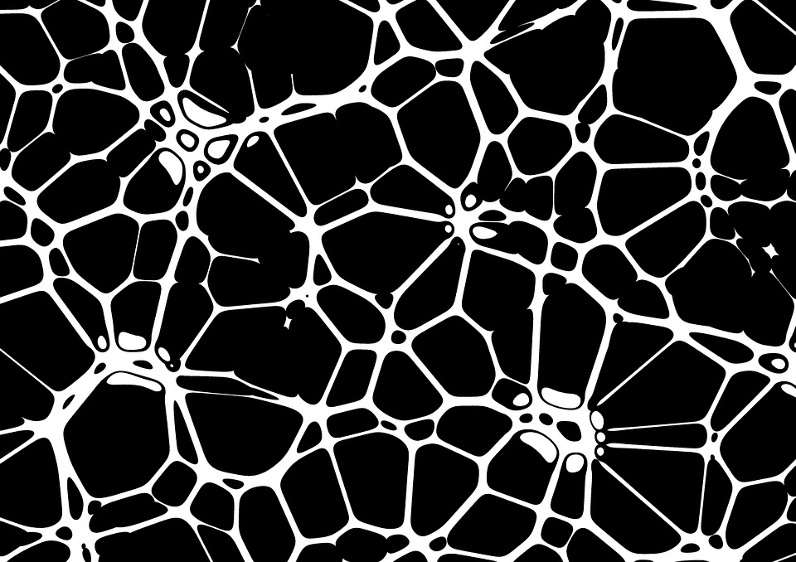
Neurotransmitter Dysregulation
…is associated with the disease of chemical dependence and may be present at birth, be activated as a result of the use of addictive substances/behaviors or - more likely - both.
(Erickson, 2007)

Slide 9
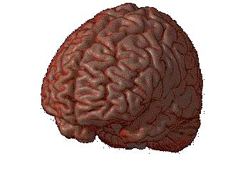
Because so much of what is happening in addiction is taking place below the neocortex and consciousness
People don’t know they are becoming addicted until it is too late!

Slide 10
Willpower?
The idea that people lack ‘willpower’ or are somehow just ‘weak’ does not correspond with the science of addiction
Eventually, loss of plasticity of neuronal responses in these centres renders abstinence beyond the each of willpower, beyond the reach of conditioning and beyond the reach of psychoanalytic insight.
(Valliant, 2012)

Slide 11
AA & Brain Science
In Alcoholics Anonymous (& other 12 step groups) Step 1 refers to an admission of the powerlessness to stop on one’s own without help
It is extremely important to explain to addicts that ‘powerlessness’ is not ‘weakness’ but is rather a process in the brain that exists due to a genetic & environmental vulnerability

Slide 12
Abuse vs. Dependency
Not everyone who abuses alcohol/drugs or other compulsive
behaviors become “dependent”
Two defining features that indicate a cross over the line from recreational use or abuse to dependency or addiction are:
a) Some loss of control
b) Inability to stop despite negative consequences or a really good reason to
Yet, if use is problematic it needs to become part of the overalL treatment

Slide 13
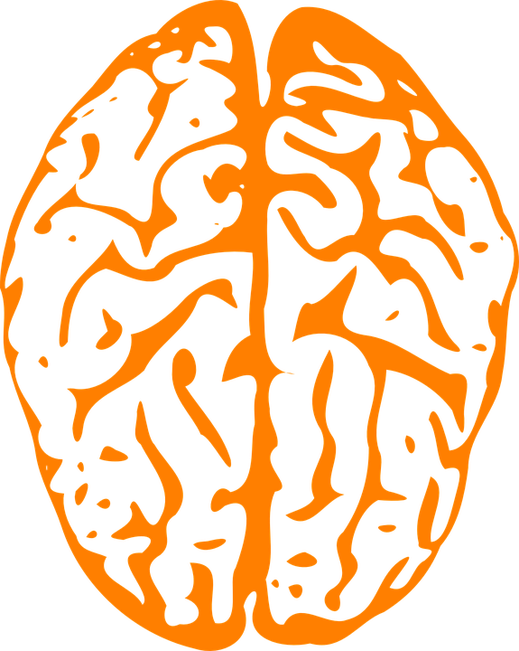
Why stress the Neuroscience?
There is no doubt that when you help people understand that they have a brain disease, rather than a moral weakness, it can help to address & mitigate the shame that is at the core of the addict’s psyche and when you do this, treatment outcomes improve

Slide 14
Why stress the Neuroscience?
As therapists we begin to understand our vital role in creating “soothing” interventions to overcome deficits in multiple brain systems by stimulating the release of oxytocin, GABA & serotonin, while promoting autonomy and motivational systems that direct dopamine & acetylcholine to work towards healthy goals
(Sheldon, 2014)

Slide 15
Recovery & Relationship Growth
This supports recovery and at the same time addresses and heals relationship issues
It helps addicts make sense of their crazy behaviors, especially in their primary attachment relationships and ⬇︎shame so they often are less defensive and more motivated to change

Slide 16
Focus in Couples Therapy with Addicts
When working with addicts in couples therapy be sure that you don’t:
Minimize, ignore or collude with the fact that they have a problem
Suggest that it’s a matter of will power instead of a medical condition that needs treatment
Forget the partner’s role
Let countertransference issues play out (S.Brown)

Slide 17
Focus in Couples Therapy with Addicts
Instead, move back and forth between the addiction/problem and the relationship work. So, be sure to:
Bring it up; keep it on the table
Educate both partners
Connect the use to other relationship problems
Ask for collaboration/encourage self-confrontation (Bader) (strengthening pre-frontal areas of the brain & core consciousness releases GABA & acetylcholine)

Slide 18
Self-Absorption in the Addict
“Selfishness-self-centredness! That, we think, is the root of our troubles. Driven by a hundred forms of fear, self-delusion, self-seeking and self-pity, we stepped on the toes [of others] and they retaliated…

Slide 19
Self-Absorption in the Addict
So, our troubles, we think, are basically of our own making. They arise out of ourselves, and the alcoholic is [the most] extreme example [that can be found] of self-will run riot, though he usually doesn’t think so. Above everything, we alcoholics must be rid of this selfishness.”
(Alcoholics Anonymous, p.62)

Slide 20
A Perfect Fit
Developmental Couples Therapy is an extremely effective intervention with addicts at any stage of recovery
The self-absorption is so much a part of the make-up of the addict, that addressing this issue as a core element of their recovery, can and does strengthen their desire for overall change

Slide 21
Emotional Sobriety
When working with addicts in couples therapy, do not assume that because they have multiple years of not indulging in their drug of choice, that they have the capacity to emotionally regulate their behavior when stressed by their partners
Addicts who lack emotional sobriety lack an ability to live with both social & intimate connection
(Dayton, 2010)

Slide 22
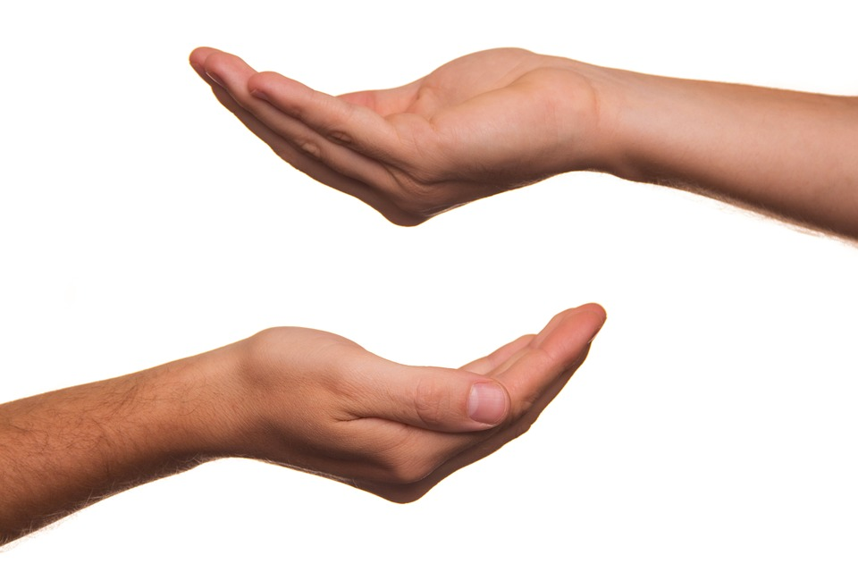
Perceptual Distortions & Self-Absorption
Often you will find that the addict believes they are more giving than they really are

Slide 23
Developmental Couples Therapy Changes the Brain
The unconditional, non-judgemental support of the therapist making developmental assists releases oxytocin and serotonin (calming the amygdala).
Holding and promoting tension-activating self-differentiation in Initiator role promotes increase in GABA & acetylcholine, reducing fear and strengthening neuroplasticity.
Promoting curiosity that is stressed in the Inquirer role releases dopamine that is harnessed for ‘other-differentiation’ and cements long-term change.

Slide 24
Developmental Couples Therapy Changes the Brain
The overall focus on creating novelty that is often counter-intuitive along with self-activating goals creates a force that supports new neuronal growth.
Overtime, this translates into co-creating a stable interpersonal relationship pattern that soothes and nurtures each of them and each other.

Slide 25
Conclusion
Treatment is complex and demands that we be flexible but also understand the seriousness of the client’s condition.
Therapist has to hold the truth and continue to push for ‘reality’ to prevail, because addiction is steeped in fantasy & delusion.
Move between the demands of active recovery (behavioral changes) and developmental healing of the self-absorption.
Stay calm and through neuro-personal resonance, be a brain that can promote neuro-plasticity in the direction of healing.
Stay hopeful and communicate the possibility of a brighter future, free from addiction - to be the container of what is possible and to keep nudging them towards it.

Slide 26
References & Resources
Addiction & Trauma (T. Dayton, 2000)
Alcoholics Anonymous: Cult or Cure? (G. Valliant, 2007) Keynote. Vancouver Addictions & Mental Health Conf.
Audit/Cage Test: http://www.additionsandrecovery.org/addiction-self-test.htm
The Craving Brain (R. Rudin, 1997)
Emotional Sobriety: From Relationship Trauma to Resilience & Balance (T. Dayton, 2007)
The Mindful Brain (D. Siegel, 2007)
Multi-Dimensional Psychotherapy & Multiple Brain Systems (A. Sheldon & B. Sheldon) Bellefield Conf. April 2014
The Neuroscience of Addiction (Walker, 2008 - Center on Drug & Alcohol Research). http://cdar.uky.edu/Downloads/The_Science_of_Addiction_-_Mar_2008_-_NKY.pdf
The Science of Addiction (C. Erickson, 2007)
Treating the Alcoholic Family System (S. Brown, 1999)
When Your Brain Can’t Say No (M. Lemonick) in TIME - Your Brain: A User’s Guide, 2012.

